Slide 1
Formula 1 racing
Proposal project for :
Tuwaiq_Four_Week
the T5 Bootcamp
Submitted by:
Mohammed Almatrood

Slide 2
Formula One (also known as Formula 1 or F1)
How are points calculated for competitors in Formula One races?
the highest class of international auto racing for single-seater formula racing cars sanctioned by the Fédération Internationale de l'Automobile (FIA).
Points Official race distances covered and race cut speed must be calculated for each professional driver

Slide 3
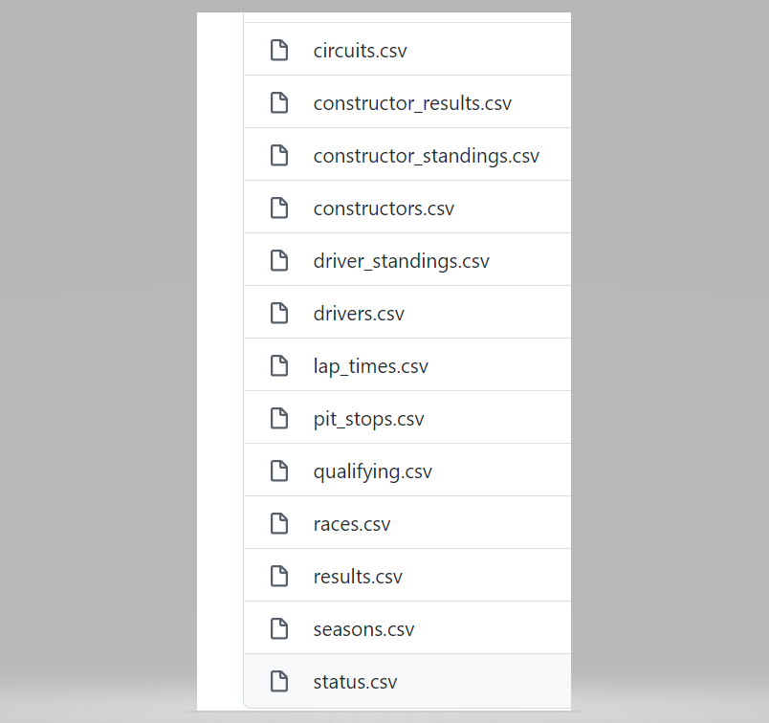
From : Ergast Developer API CSV Database Tables
Dataset
We will use 13 database tables to obtain our required models.

Slide 4
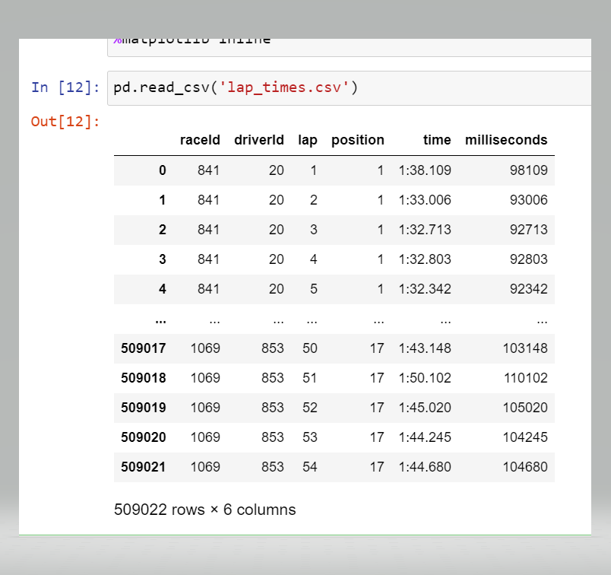
Each database contains different items about the driver, time, race type, race location and race finish time.
The datasets are available as the .csv files

Slide 5
Tools : There are tools that will be used to achieve the goal of this study, such as: TensorFlow, matplotlib, pandas, nltk for discovering the data and train a model. The work will be done through Jupyter notebook. Furthermore, the Sentiment Analysis from nltk will be used to determine the target of the data in order to train the model in supervised manner.

